Slide 1
Red Line Voting:
effective stewardship for your scheme
Presented by <insert name here> / <Date>

Slide 2
What is stewardship?
Stewardship is the process whereby investors engage with investee companies and exercise their voting rights to promote long-term corporate success.
Good stewardship will:
Boost returns - well monitored companies will tend to be well-governed and will outperform over time
Limit the volatility of assets as downside risk is reduced
Limit the reputational risk to trustees and sponsors stemming from ownership of “bad” companies
It’s increasingly expected:
Under the UK Stewardship Code there is an expectation that UK institutional investors (including pension funds) should contribute to a robust financial system through encouraging stewardship activity. Willis Towers Watson
Notes:
From the Pension Regulator:
Statement of investment principles
The statement of investment principles (SIP) must include your policy on:
choosing investments
the kinds of investments to be held, and the balance between different kinds of investment
risk, including how risk is to be measured and managed
the expected return on investments
cashing in investments, and
the extent, if at all, you take account of social, environmental or ethical considerations when taking investment decisions
using the rights (including voting rights) attached to investments if you have them.

Slide 3
Our stewardship responsibility
No doubt that Trustees have a responsibility: Kay review / Law Commission / public opinion
The Financial Reporting Council’s UK Stewardship Code sets out areas of good practice and steps that institutional investors can take to protect and enhance the value that accrues to the ultimate beneficiary.
The 2014 Law Commission Report into trustees’ fiduciary duties concluded that trustees should take financially material factors into account and that these may include environmental and social issues as well as corporate governance matters.
Notes:
An opportunity to enhance shareholder value
Stewardship (voting or engaging) can influence companies to operate in a more sustainable way with a focus on long-term risks or opportunities. Evidence supports a link between companies with better management of ESG issues and improved risk-adjusted returns.
Good risk management
The process of researching companies to identify issues, such as ESG factors, that may impact long-term shareholder value helps a portfolio manager to be aware of potential risks within a portfolio.
Voting and engagement support a robust investment system
The system of publicly-owned companies is structured in such a way that shareholders are owners of the company, with the management of the company delegated to an executive board of directors. For such a structure to operate efficiently and effectively, it requires shareholders to be effective stewards of the companies in which they invest, providing oversight of the board.
Alleviate potential governance failures
The financial crisis revealed shortcomings in corporate governance. When most needed, existing standards failed to provide the checks and balances that companies need in order to cultivate sound business practices. Better risk management and alignment of interests are two elements that are frequently identified as requiring attention by the players in the investment chain.
Demonstrate investor responsibility
‘Free-riding’ is a term used to describe shareholders that may benefit from the corporate engagement activities of others without the investment of their own resources.
‘Absentee landlord’ is another term used to describe investors that do not undertake any shareowner responsibilities such as voting or engagement.
Asset owner and asset management stewardship responsibilities are highlighted in the Financial Reporting Council’s UK Stewardship Code and other similar national equivalents, although typically these are good practice codes rather than compulsory. For example, the UK Stewardship Code recommends that institutional investors should seek to vote all shares held and that they should not automatically support the board.
Protect your pension scheme’s reputation
Many organisations are aware of their duties as good corporate citizens. This view is extending to the reputation and responsibility of pension funds and their underlying members. Developing a position on stewardship is considered one way to protect or enhance that reputation.
Many asset owners, especially larger groups, have

Slide 4
Good stewardship results in better performance
Oxford University/Arabesque study
80% show that stock price performance of companies is positively influenced by good sustainability practices.
88% show that solid ESG practices result in better operational performance
90% of the studies on the cost of capital show that sound sustainability standards lower the cost of capital of companies
International Finance Corporation/ World Bank:
“Good corporate governance won’t just keep your companies out of trouble. Well-governed companies often draw huge investment premiums, get access to cheaper debt, and outperform their peers.”
Study by Harvard Business School and Dept of Economics, and the Wharton School, University of Pennsylvania:
“If an investor purchased shares in US firms with the strongest shareholder rights and sold shares in those with the weakest, the investor would have earned abnormal returns of 8.5% a year.”
Studies on the cost of capital show that sound sustainability standards lower the cost of capital of companies
Notes:
The Oxford University/Arabesque study was based on more than 200 academic studies, reports and books
Quotes from the study:
“Active ownership allows investors to influence corporate behavior and benefit from improvements in sustainable business practices.”
“The future of sustainable investing is likely to be active ownership by multiple stakeholder groups including investors and consumers.”
Another quote you can use:
Dan Hanson, Managing Director, BlackRock:
“ESG is a proxy for risk that is not priced in, and companies that better manage these risks can deliver returns with greater certainty”
Another example: Deutsche Bank
Report for the Asset Management Working Group of the UN Environment Programme Finance Initiative: their study of S&P 500 firms showed that companies with strong or improving corporate governance outperformed those with poor or deteriorating governance practices by about 19% over a two-year period.
“Investments in companies with the highest quality of governance structures and behaviour have significantly outperformed those with the weakest governance.”

Slide 5
The costs of poor stewardship
Deloitte: Finding the Value in ESG performance:
Indirectly or directly, ESG impacts performance:
Environmental, social, and governance (ESG) issues can impact company financial performance tied directly to its operations or products, or indirectly through stakeholder actions along the entire value chain, for example:
Direct operations risk – accidents/spills/equipment failure
Environmental: pollution, e.g., carbon emissions, water pollution, penalties, and fines
Social: employee strikes, wage concerns, health and safety
Governance: Board composition and independence

Slide 6
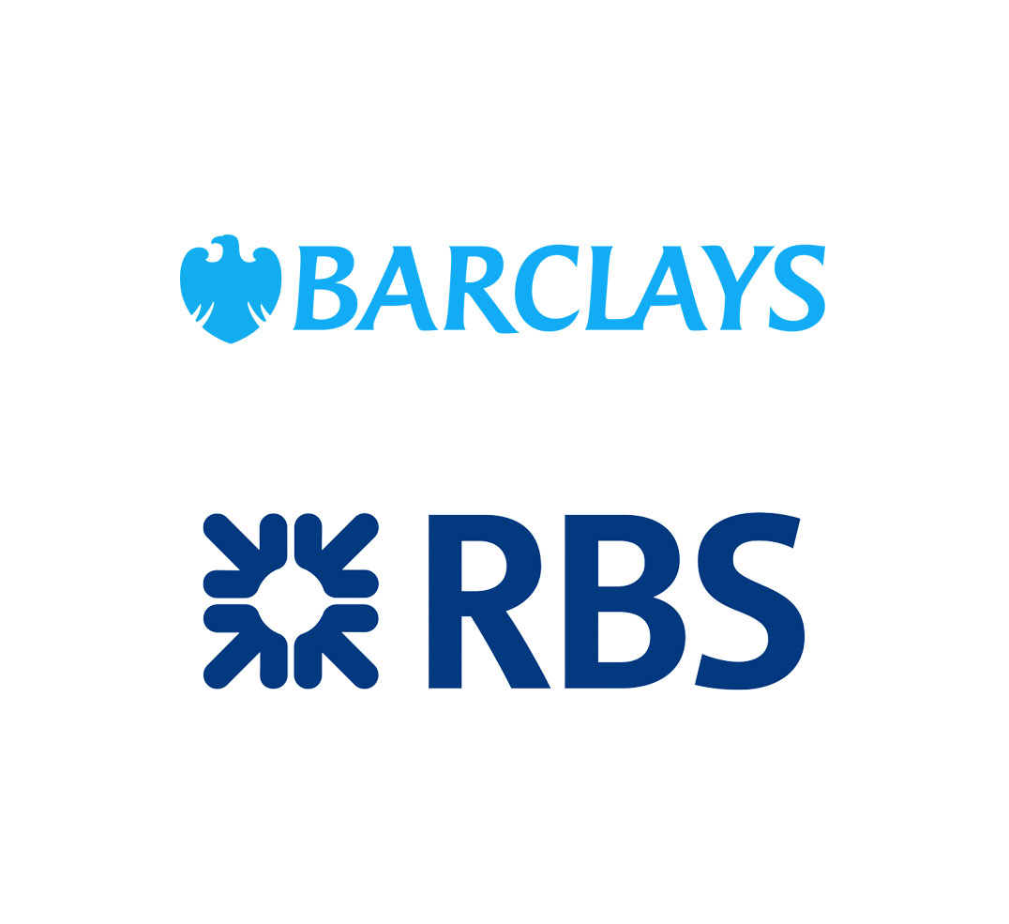
When companies get it wrong
BP gave chief executive Bob Dudley a £14-million pay package despite falling profits and job cuts
Volkwagen faces billions in fines after installing deceptive software in about 11-million diesel cars
Barclays and RBS were among a group of six global banks fined almost US$6-billion for rigging the foreign exchange market

Slide 7
Institutional investors (including pension scheme trustees) should seek to improve companies’ long-term risk-adjusted returns to their shareholders through the quality of their stewardship.
Stewardship includes engagement and exercising voting rights. Boards will set policies on this, disclose these policies in their SIPs, monitor how they are being implemented and report regularly to members.

Slide 8
How well do you meet your responsibilities?
Delegating everything to the fund managers and failing to hold them to account is probably insufficient
Delegating to multiple fund managers risks contradictory engagement and voting actions (and may make you look foolish)
A corporate governance policy is a great start but it needs to be complemented by policies on the environment and social issues
All your assets matter - your approach cannot be limited to segregated funds
Funds typically have problems in some or all of these areas…
What does your SIP currently say?

Slide 9
Issues
Trustee time and resource to address
Attitudes of advisers and fund managers
Finding the right service
Red Line voting has been developed by trustees for trustees to address these problems
Notes:
Some professional advisers seem to take the view that small funds cannot get involved in responsible investment. This position was rejected by the Law Commission.

Slide 10
Red Line Voting
The Red Lines are voting instructions on the key Environmental, Social and Corporate Governance issues
They are proportionate, set at the level of best practice guided by the UK Governance Code, the UN Global Compact, the FRC and CDP
They are the UK’s first easy-to-use template policies on the environment and on social issues
They apply to UK stock market-listed investments
They link to resolutions typically laid at all AGMs They optimise the use of existing tools and procedures
Notes:
How were the Red Lines developed?
Environment: based on the United Nations Global Compact, assisted by expert advice including CDP
Social: based on the UN Global Compact and in furtherance of the Financial Reporting Council’s UK Corporate Governance Code
Corporate Governance: largely based on the consensus found in a study of some of the largest schemes, in furtherance of the UK Corporate Governance Code
Over a year of discussion at AMNT open meetings and adopted by a vote of members.
Working group of AMNT members plus the United Kingdom Sustainable Investment and Finance Association, and ShareAction
Consultation with the financial services industry via UKSIF
Technical support from BIS
The 10 principles of the United Nations Global Compact:
The UN Global Compact asks companies to embrace, support and enact, within their sphere of influence, a set of core values in the areas of human rights, labour standards, the environment and anti-corruption:
Human Rights:
Principle 1: Businesses should support and respect the protection of internationally proclaimed human rights; and
Principle 2: make sure that they are not complicit in human rights abuses.
Labour
Principle 3: Businesses should uphold the freedom of association and the effective recognition of the right to collective bargaining;
Principle 4: the elimination of all forms of forced and compulsory labour;
Principle 5: the effective abolition of child labour; and
Principle 6: the elimination of discrimination in respect of employment and occupation.
Environment
Principle 7: Businesses should support a precautionary approach to environmental challenges;
Principle 8: undertake initiatives to promote greater environmental responsibility; and
Principle 9: encourage the development and diffusion of environmentally friendly technologies.
Anti-corruption
Principle 10: Businesses should work against corruption in all its forms, including extortion and bribery.

Slide 11
The Red Lines are not about stock selection
“Ethical investment” is usually taken to mean taking investment decisions on the basis of ethical concerns – e.g. divesting from tobacco or weapons companies. Red Line Voting is not connected with this.
Red Line Voting is about ensuring the long-term sustainability of your existing equity investments whatever they are.
Red Line Voting: effective stewardship of your scheme / 11

Slide 12
What do the Red Lines cover?
Environment
Based on the UN Global Compact, drawn up with expert assistance from CDP, which states that if these Red Lines are widely adopted they would be a game-changer in driving corporate change to address climate change
Social
Based on the UN Global compact, focusses on equality, low pay, trade union recognition, political donations, breach of labour standards or law
NB. the United Nations Global Compact is globally endorsed by governments and 13,000 corporate participants and other stakeholders in over 170 countries
Corporate governance
In accordance with the UK Corporate Governance Code and following survey of major pension schemes’ policies. Includes policies on directors, auditors, executive pay, tax policy, takeovers, dividends
Notes:
CDP, formerly known as the Carbon Disclosure Project, is backed by more than 800 institutional investors representing an excess of US$100 trillion in assets. CDP gives investors access to a global source of year-on-year information that supports long-term objective analysis. This includes evidence and insight into companies’ greenhouse gas emissions, water usage and strategies for managing climate change, water and deforestation risks.

Slide 13
The Red Lines (summary)
E.) Environment
Developed in accordance with the United Nations Global Compact
S.) Social
Developed in accordance with the United Nations Global Compact & UK Corporate Governance Code
G.) Corporate governance
Developed in accordance with the UK Corporate Governance Code
Climate change: Environmental Sustainability
Corporate Social Responsibility
Directors and the Nomination Committee
Climate change: disclosure of information
Equality monitoring & ethnic representation
Auditors & Audit Committee
Climate change: international agreement
Women on boards
Tax policy
Climate change: emission reduction
Living wage and contracts
Pre-emption rights
Environmental damage
UN Global Compact standards: trade unions
Takeovers / Dividens
Executive remuneration & Director wages
Labour standards & Law
Executive remuneration & Director wages

Slide 14
“Comply or explain”
Comply or explain: your fund managers are at liberty to vote contrary to a Red Line if they judge that to be in the client’s interests – but if they do they are required to explain why they did so.

Slide 15
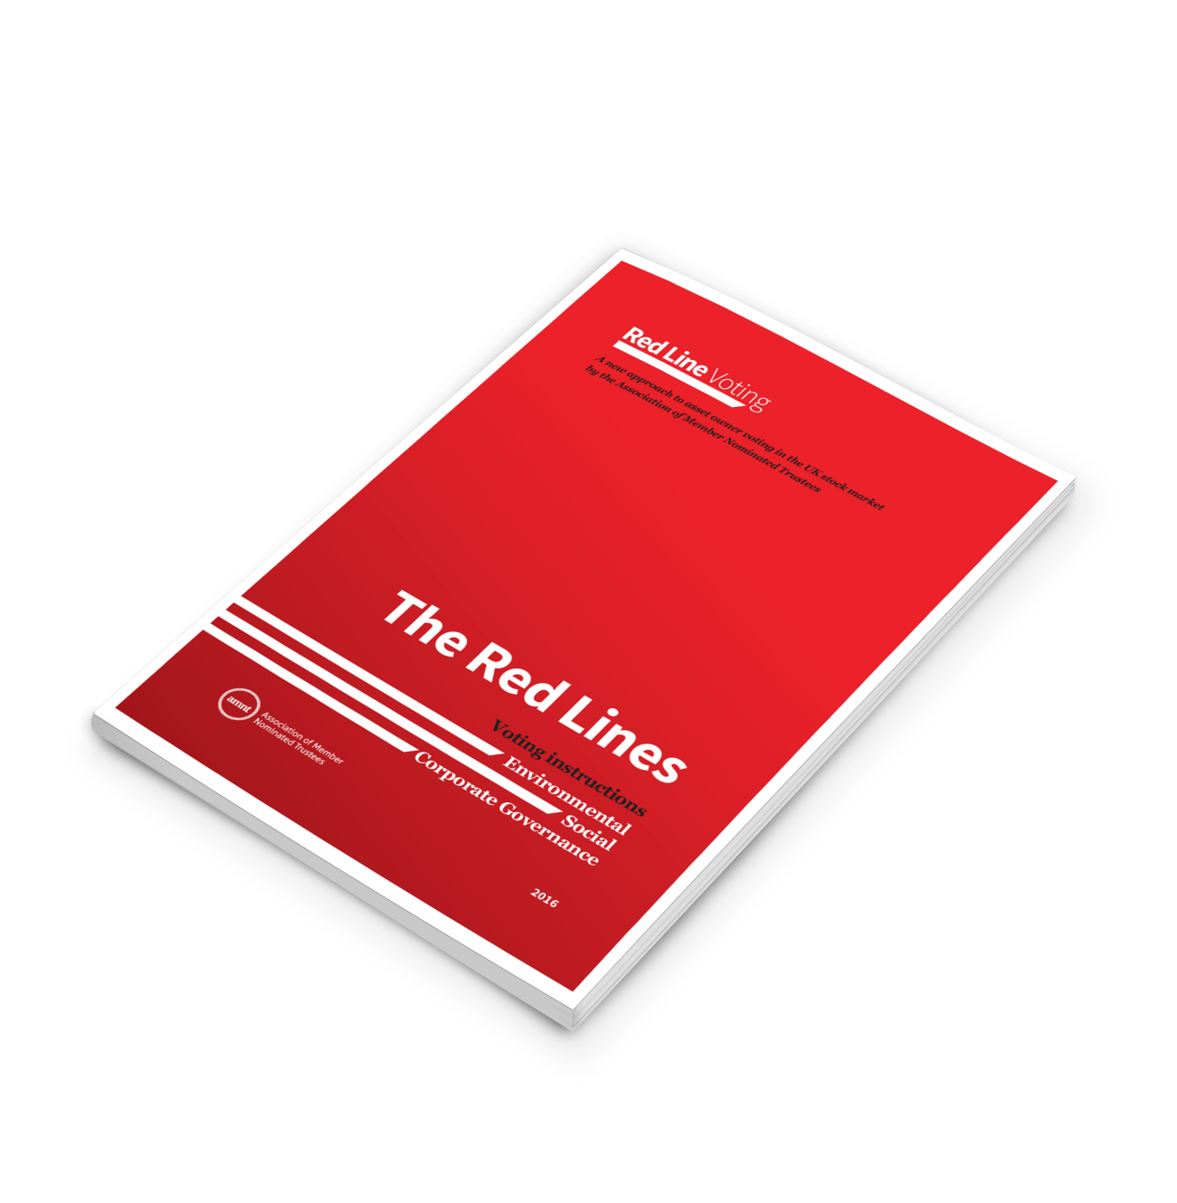
Issue: trustees’ time and resource
The Red Lines have been drafted for you
The briefing document says why each issue was chosen, why the recommended position as adopted and why the vote is proportionate
Each Red Line is stand-alone, you can instruct all or some of them
A pro forma trustee board paper has been drafted which makes the case for adoption and outlines the process for implementation
Implementation is for your agents NOT for the trustees
Use of the Red Lines will allow the trustee board to rapidly introduce a policy across all of E, S and G and to demonstrate a recognition of and response to the evolving demands of fiduciary duty

Slide 16
Issue: Attitudes of advisers and fund managers
Substantially all advisers and Fund Managers will claim policies or expertise in these areas
All should understand the drivers, some will resent you “trespassing” But they’re not the ones on the hook
AMNT has discussed the Red Lines widely. Few people and no “bloc” has made meaningful criticism of them
Much comment reflects “not invented here”

Slide 17
Challenges we have heard and the responses:
“Trustees should not give instructions on particular votes”
“We disagree with a Red Line”
“It’s operationally difficult and/or expensive”
This is correct but trustees must make it clear they understand their responsibility and have a robust, credible approach – Red Lines does this
A key element is “comply or explain”. A fund manager may vote contrary to your instruction as long as they report why. You and they should welcome this dialogue
Clients adopting the Red Lines show the importance of these topics and empower the FM professionals
Trustees face a changing burden and their service providers should adjust.

Slide 18
Too much work will increase costs – proxy voting agency templates already in the market for their convenience (ask AMNT for more details)
They hold assets in collective pooled funds - in the UK they can and should still be able to vote in proportion to their instructions received, and in any case the adoption of Red Lines builds a collective approach which is more efficient for them
Their fund custodian uses a nominee account for many holdings - if the asset manager reports to the scheme individually then they have the ability to vote specifically and they should sort their systems
It is their job to judge voting decisions - Red Lines are based on best practice and again there is the comply or explain option
Investment is via a platform so scheme does not technically own the assets - perhaps correct but they should wish to recognise beneficial ownership and seek to deliver on client requirements
If you buy into the fund you’re buying their policies – the trustees have a responsibility to set their own policy which is particularly important for schemes with multiple fund managers who may have conflicting policies. Is the fund manager refusing to allow the trustees to fulfil their fiduciary responsibilities as set out by the Law Commission?
But they have special relationships they have to manage – exactly why Red Lines are needed!

Slide 19
Pooled funds are included
Almost half of the assets managed in the UK are in pooled funds
Traditionally, client instructions have been few and they have been resisted
This sits badly with the new recognition that trustees have a responsibility for key areas which cannot be delegated
A fundamental reform of voting is probably needed. But while we wait for that reform, Red Lines enable trustees to set responsible investment policies in a way that makes it easier for pooled fund managers to work with.

Slide 20
Issue: finding the right service
Any segregated portfolio should be able to instruct Red Lines
The reaction of managers of pooled funds is to cite operational difficulties over accepting voting instructions
But some do for large clients, and others have indicated for the PLSA website that they can accept instructions
Some managers of pooled funds are reluctant to allow trustees to set their responsible investment agenda. These fund managers need to adjust to the reality of the Law Commission responsibilities on trustees to do precisely this.
Your professional advisers should be encouraging you to fulfil your fiduciary duty in the manner set out by the Law Commission, TPR and UK Stewardship Code, rather than discouraging you.
Voting in the UK is a complex process involving fund managers, proxy agents, custodians and registrars. This complexity should not prevent you establishing the policy you feel is appropriate
Notes:
How to implement the Red Lines – in brief:
Your pension scheme decides whether to adopt all or some of the Red Lines
Your scheme instructs your fund managers to use the votes associated with your investments in accordance with the Red Lines you have adopted. You revise your SIP accordingly.
The fund managers are at liberty to vote contrary to the Red Lines if in individual circumstances they believe that is in the investor’s interests
If they do, they are required to explain to you why they did so.
The trustees receive their reports periodically: table them for discussion at the board or investment committee. If the board is not satisfied with the fund managers’ actions they should take appropriate action, such as in the first instance discussing it with the fund managers
AMNT has made clear that it does not expect pension schemes to have to pay any extra to the fund managers for adopting Red Line Voting.

Slide 21
Recognition
The Pensions Regulator and the Financial Reporting Council have referenced Red Line Voting
Statements of support from
United Nations Global Compact
Rt Hon Sir Vince Cable as Secretary of State for Business Innovation and Skills USS, Railpen, Women on Boards UK, Willis Towers Watson, LCP
CDP – who state that if widely adopted the environmental Red Lines could be a game-changer in driving corporate change on climate change

Slide 22
How do we implement the Red Lines?
1
The board reviews the Red Lines and decides whether to adopt some or all of them.
The scheme writes the the fund manager(s) asking them to implement Red Line Voting in accordance with the board’s decision – the Red Line Voting website has suggested draft letters.
The fund managers will be advised that they are ‘comply or explain’
4
The trustees will expect regular reporting on implementation
For new mandates include the Red Lines during beauty parades and in new agreements
Review and amend SIP
2
5
6
3

Slide 23
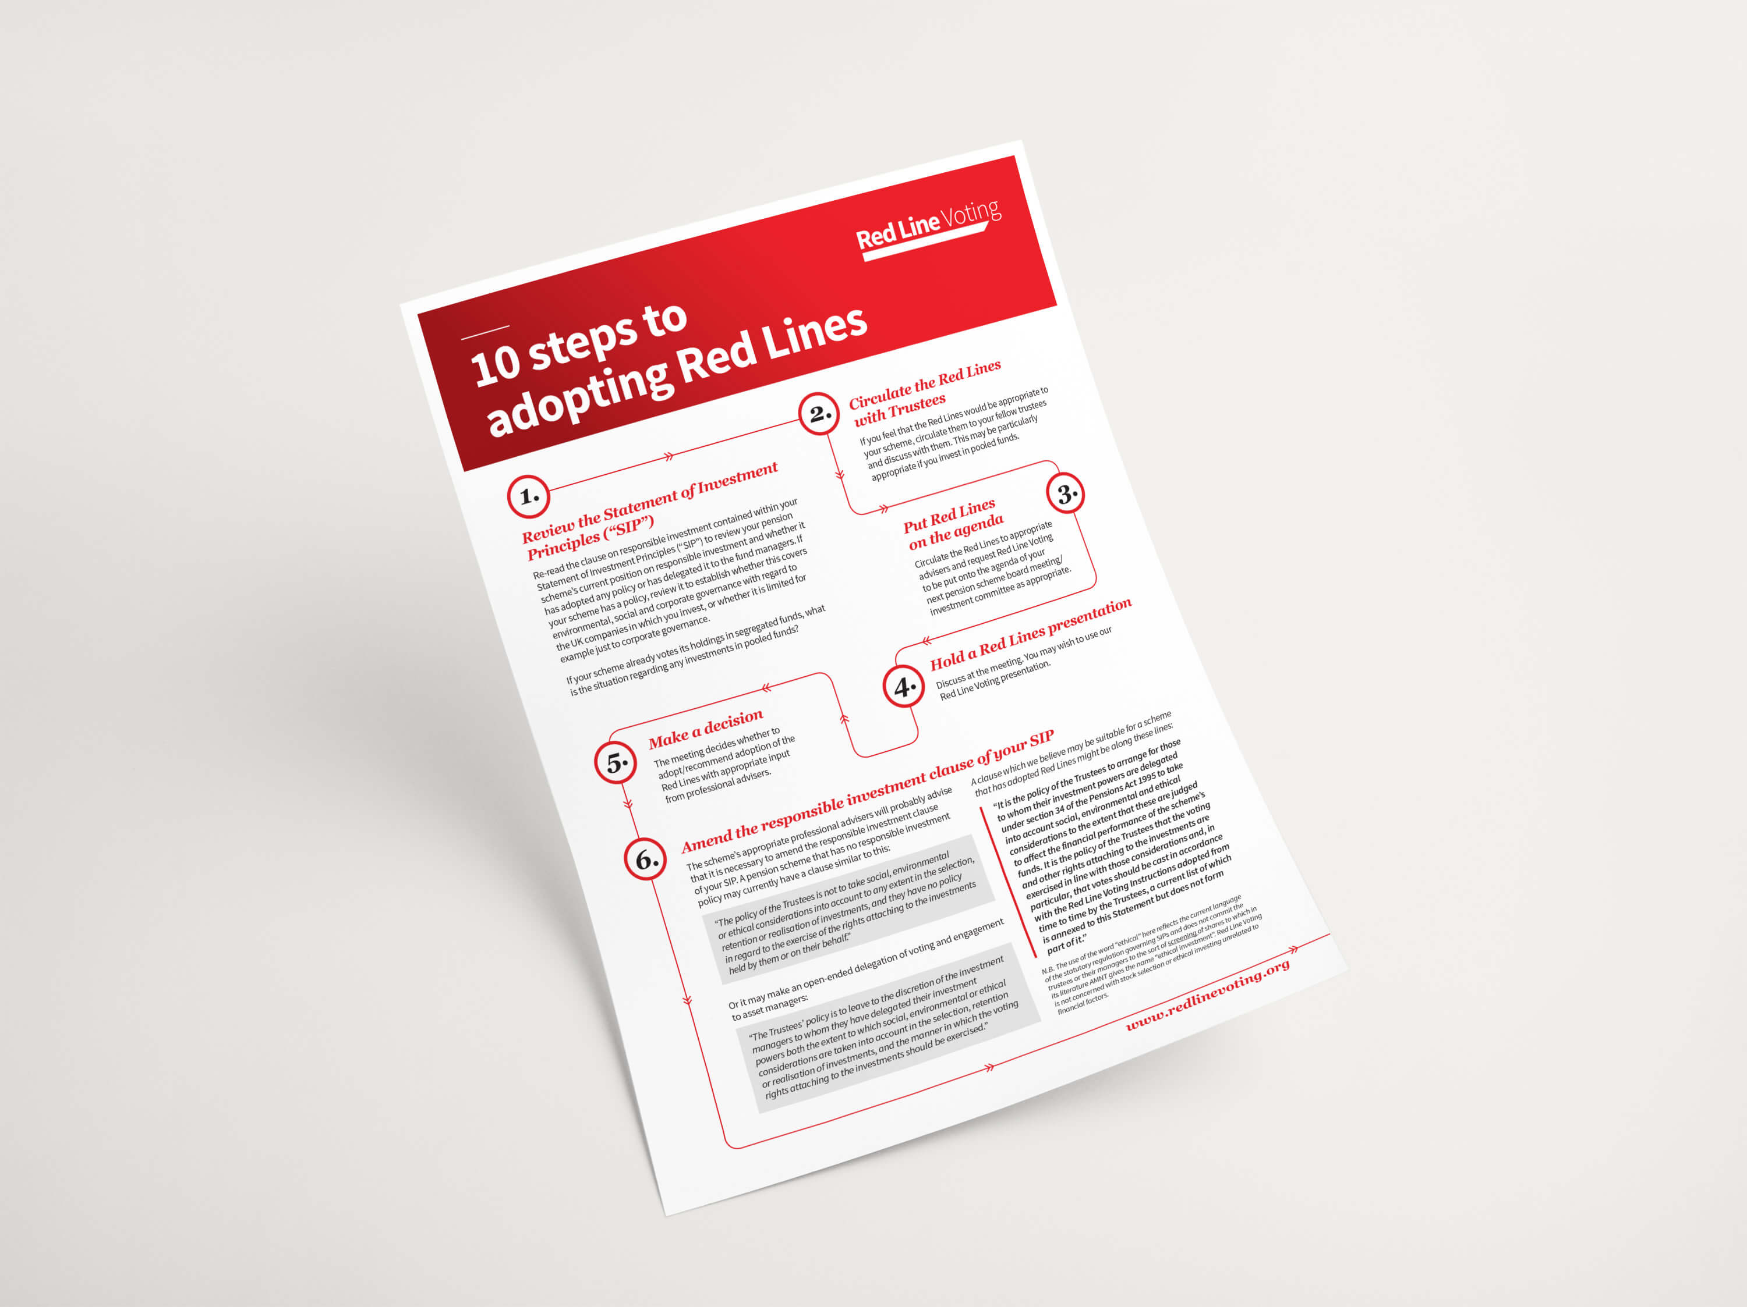
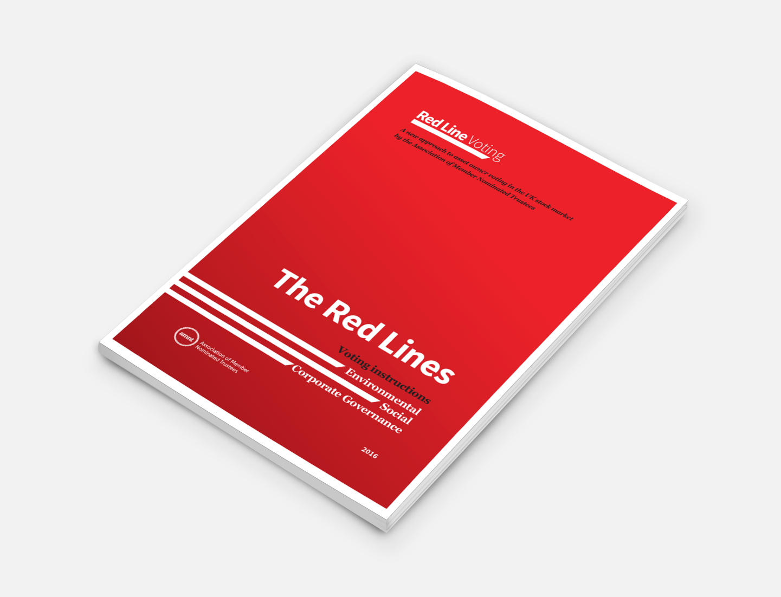
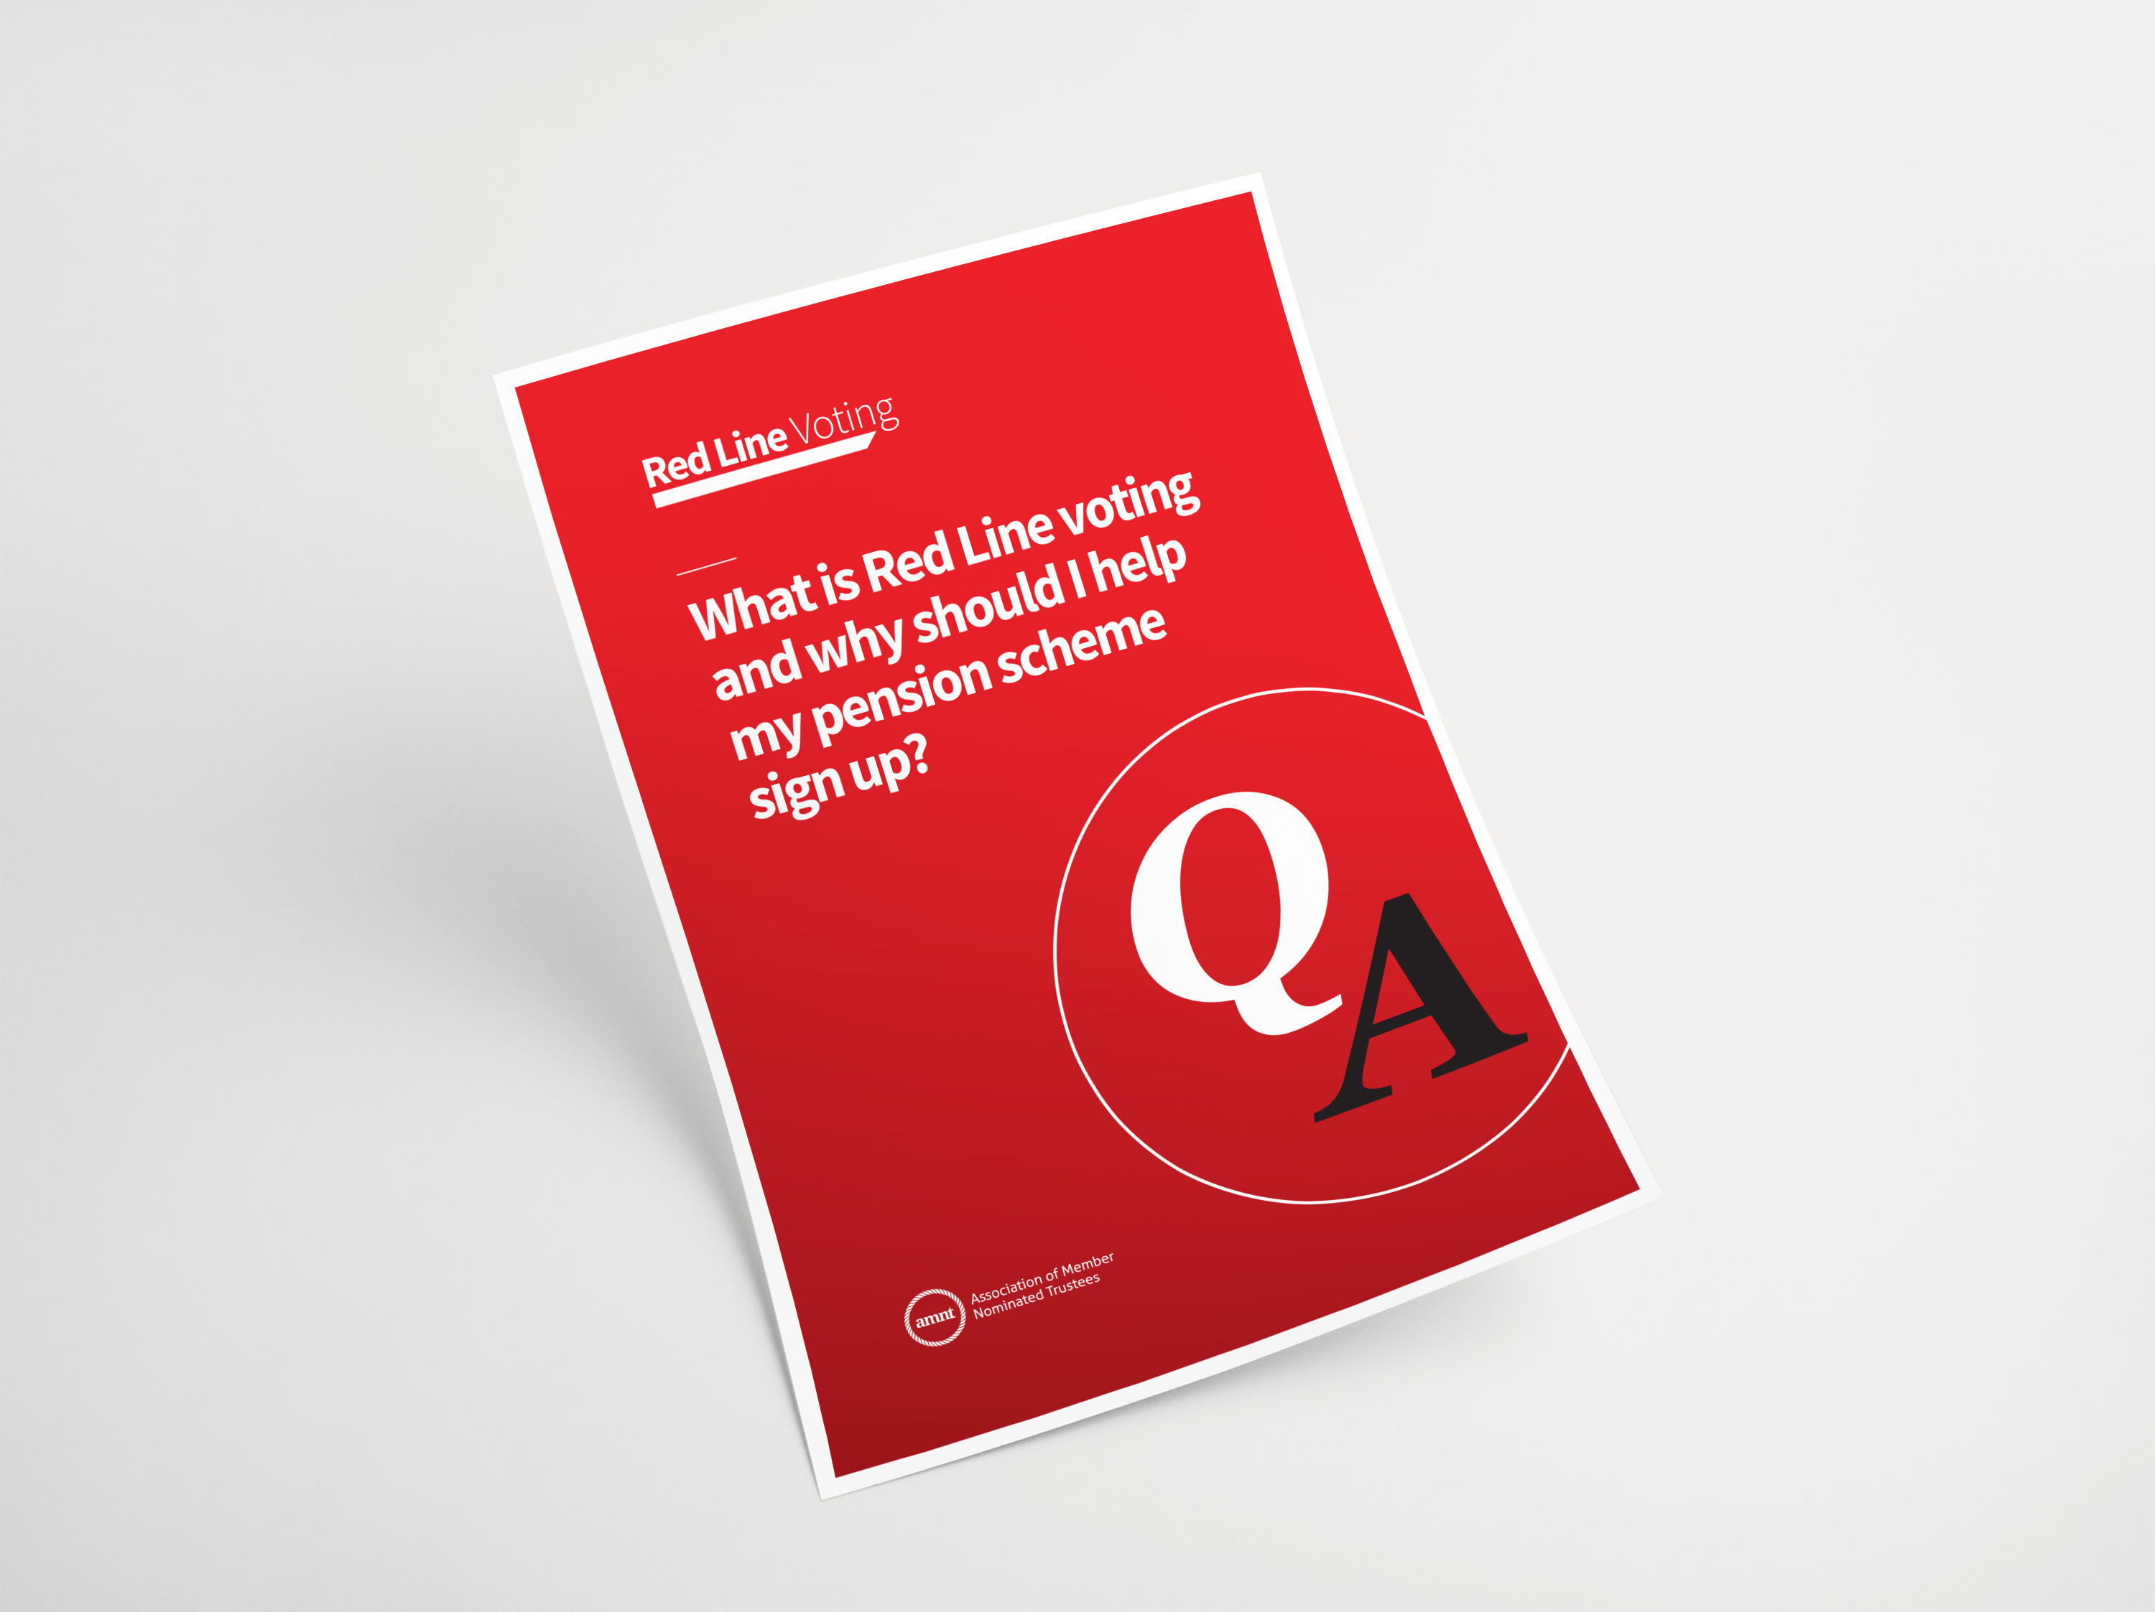
For more information
Ten steps to adopting Red Lines
The Red Lines brochure
Red Lines Questions and answers
To find out about the Red Lines in more detail, download our information pack from www.redlinevoting.org

Slide 24
Conclusion and summary
The Red Lines are an easy way for Trustees to demonstrate ownership and management of their stewardship and fiduciary responsibilities
They have an important part to play in risk management at the trustee level
They will drive risk control and investment optimisation in portfolios
They are drafted at a proportionate and sensible level, driven by recognised best practice guides e.g. the Corporate Governance code
Trustees instruct their agents to act and implement
Professionals are empowered and protected by “comply and explain”
Trustees will expect reports to hold their fund managers to account for their implementation

Slide 25
Thank you!
For more information please contact
Bridget Hiluta at bridget.hiluta@amnt.org
visit www.redlinevoting.org
Follow @redlinevoting

